Slide 1

CDISC 360i Summer Pulse Check
2025 – July - 31

Slide 2
CRF and aCRF Update
2025-07-31

Slide 3
CRF and aCRF
Current CRF and aCRF generation
The way CRFs and aCRFs are generated today to provide a baseline
Depending on eCRF vendor
To-Be CRF and aCRF generation
360i way of generating CRFs and aCRFs using USDM + BCs + Collection DSSs
This will need additional form metadata
Create software to automate the generation of CRFs and aCRFs
Long-term
New process for creating eCRFs (CRFS and aCRFs)

Slide 4


High-level Roadmap Phase 1
2
CRFs & eDTs
1
Study Design
SDTM Define-XML
Shell Datasets
3
Populate CRFs
ODS
5
6
7
8
sdtm.oak algorithms
9
SDTM Datasets
4
aCRFs
Conformance Report
Open Rule Set
10
Roadmap does not need to be completed sequentially in all cases
11
Notes:
This roadmap highlights the key deliverables our teams are addressing along the clinical data pipeline—from protocol to submission.
Each mile marker along this roadmap contributes to the success of our broader 360i vision
We have noted that while this roadmap is easy to understand, it does not mean that these must be done sequentially

Slide 5










360i Study Build
eCRF Portal
Data Standards
Biomedical Concepts Analysis Concepts Foundational Standards
Safety Assessments
Demography
Death Details
Adverse Events
Overview
By SOC and PT
By Freq
Disposition
Change from Baseline Lab
Chemistry
Hematology
Vital Signs
Select eCRF templates
Generate eCRF
eCRF
Template
eCRF Specifications
Generate eDT
Define.xml
Electronic
Data Transfer (eDT)
Safety Assessments
DILI
Digital SoA
FHIR observation resource
SDTM
Specifications
Questionnaire
ADAS - COG
Digital Measure (DHT)
Glucose Monitoring
Steps / Movement / Sleep
Select eDT
Predefined eDT
Efficacy Endpoint Assessments
Breast Cancer (RECIST)
Alzheimer’s Disease
Notes:
Build is where design becomes reality—through implementation of tools, APIs, rule engines, and workflows.
It’s an iterative process, often involving early prototyping, collaboration, and refinement as needs and use cases evolve.
The goal is to create functional, easy to use solutions that are standards-aware and scalable.
~25 seonds

Slide 6
Generate CRF and aCRF
Build
Tools
Python scripts
odmlib
CDISC Library
XSLT
ODM Stylesheet
Inputs
Outputs
USDM in JSON with BCs
Collection Dataset Specializations
Forms Metadata
ODM XML
CRF as HTML
aCRF as HTML
Description:
Use USDM JSON to select needed BCs
Select Collection Dataset Specializations associated with the BCs
Find the associated forms metadata
generate an ODM
schema validate the ODM file
generate an HTML renditions for the CRF and the aCRF

Slide 7
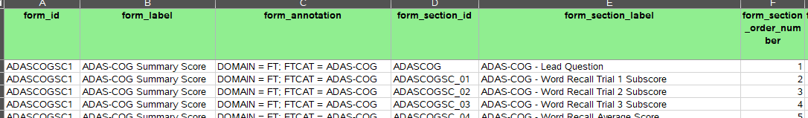
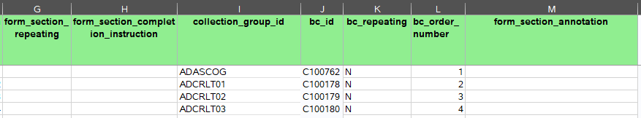
Why do we need forms metadata?
The USDM contains Biomedical Concepts needed for an activity
It may not have all the metadata needed to build ODM forms
A Biomedical Concepts can have more than one Collection Dataset Specializations associated with it.
Forms or form sections may need completion instructions or annotations

Slide 8
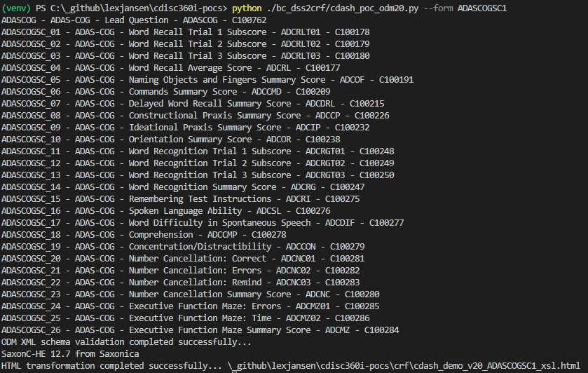
Demonstrated an Automated Process for Generating CRFs and aCRFS as an Early Experiment
python ./bc_dss2crf/cdash_poc_odm20.py --form ADASCOGSC1
GitHub: https://github.com/lexjansen/cdisc360i-pocs

Slide 9
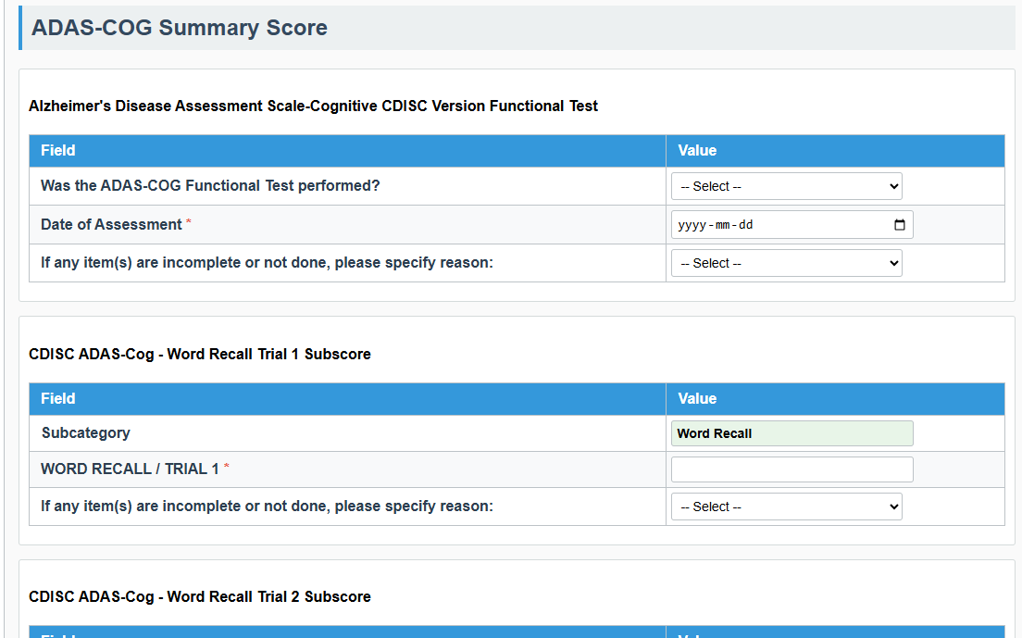
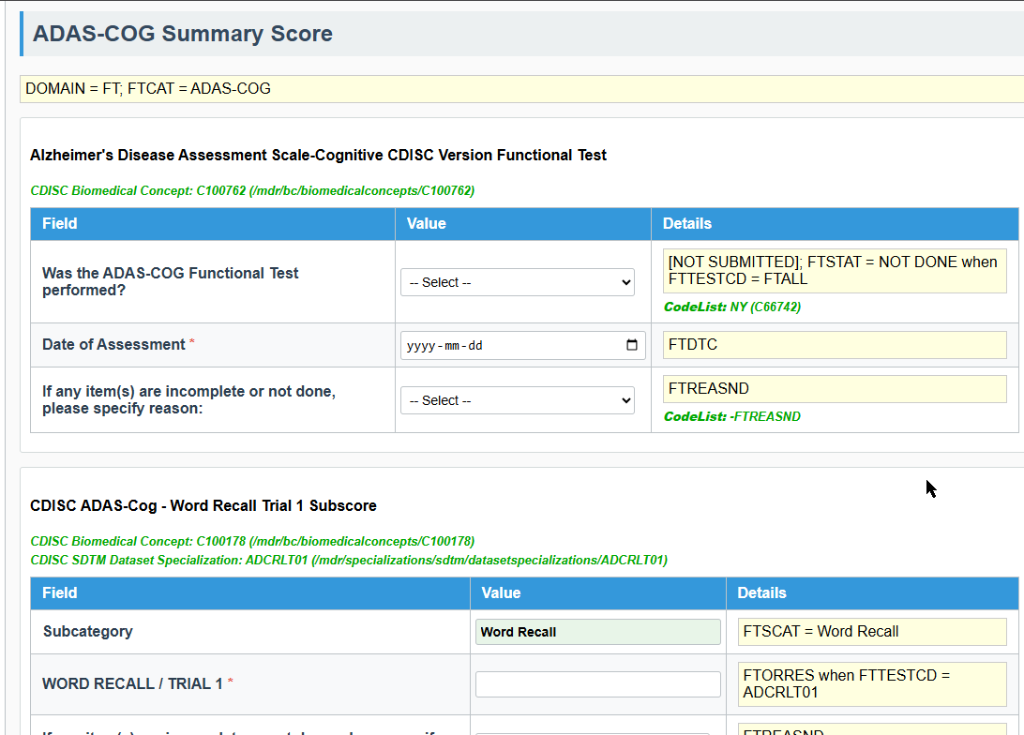
Demonstrated an Automated Process for Generating CRFs and aCRFS as an Early Experiment

Slide 10
Looking Ahead: eCRF Portal v2.0
Built on Biomedical Concepts/Collection Specializations
Include traceability from BC-Collection-SDTM
Consistent metadata
Based on ODM-xml files and mock CRF layouts using vendor-neutral stylesheets
Independent on eCRF software vendor
SDTM annotation based on MSG 2.0

